Slide 1



CUSTOMER RELATIONSHIP MANAGEMENT
Applications of CRM Techniques
at Ford Motor Company
Customer Relationship Management Project
PRESENTED BY
Sujana S
Daphni Michelle B
Sree Darshne J
Haripriya T N
FORD MOTOR COMPANY | CRM ANALYSIS 2026

Slide 2













Introduction: Modern CRM Practices
Strategic Approach to Customer Interaction
Customer Relationship Management (CRM) is a strategic approach to managing interactions with current and potential customers to maximize long-term brand health.
Customer Retention
Customer Loyalty
Strategies to keep existing customers engaged and reduce churn rates through proactive service.
Building long-term relationships through consistent value and personalized rewards programs.
Customer Equity
Relationship Marketing
The sum of lifetime values of all customers; a key metric for sustainable growth and brand health.
Focuses on nurturing ongoing relationships rather than one-time transactional interactions.
The Modern Edge: Leveraging AI, Big Data analytics, and Omni-channel communication to deliver personalized experiences at scale.
"Building Enduring Relationships"

Slide 3












FORD
Company Profile: Ford Motor Company
Pioneering the Future of Mobility
GLOBAL WORKFORCE
177,000+
FOUNDED
REVENUE (2023)
1903
$185 Billion
Employees Worldwide
Henry Ford | Dearborn, MI
Fortune 500 Recognition
The Strategic Pivot
Digital Innovation
Transitioning from a traditional automaker to a customer-focused mobility company. Ford is aggressively investing in the Ford+ restructuring plan to separate business units:
"Focusing on connected vehicle technology and the FordPass digital ecosystem to redefine customer relationships."
FORDPASS APP
OTA UPDATES
Ford Blue: Optimizing the iconic ICE (Internal Combustion Engine) portfolio including the legendary F-Series.
FORD CREDIT
CONNECTED DATA
Ford Model e: Scaling high-growth electric vehicles and software-driven digital ecosystems.
Leading the EV Revolution: F-150 Lightning & Mustang Mach-E
FORD MOTOR COMPANY | CRM CASE STUDY
03

Slide 4














CRM Evolution at Ford
From Transactional Dealer Systems to AI-Powered Mobility
1990S
2000S
2010S
2016+
2021+
Early Dealer Systems
Integrated Financing
Digital Channels
FordPass Ecosystem
AI & Ford+ Plan
Localized data management and basic tools for dealer networks.
Ford Credit integration & Blue Oval customer service certification.
Online configurators, customer portals, and marketing automation.
Connected vehicle services, remote features, and loyalty rewards.
Predictive maintenance, churn models, and digital-first mobility.
Strategic Shift: Ford has transitioned from a traditional automaker to a customer-focused mobility company, separating EV (Model e) and ICE (Ford Blue) units to optimize the digital customer journey.

Slide 5



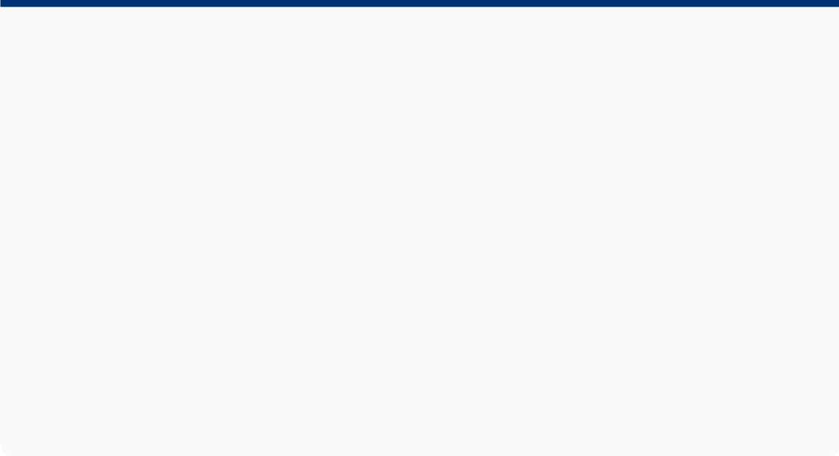
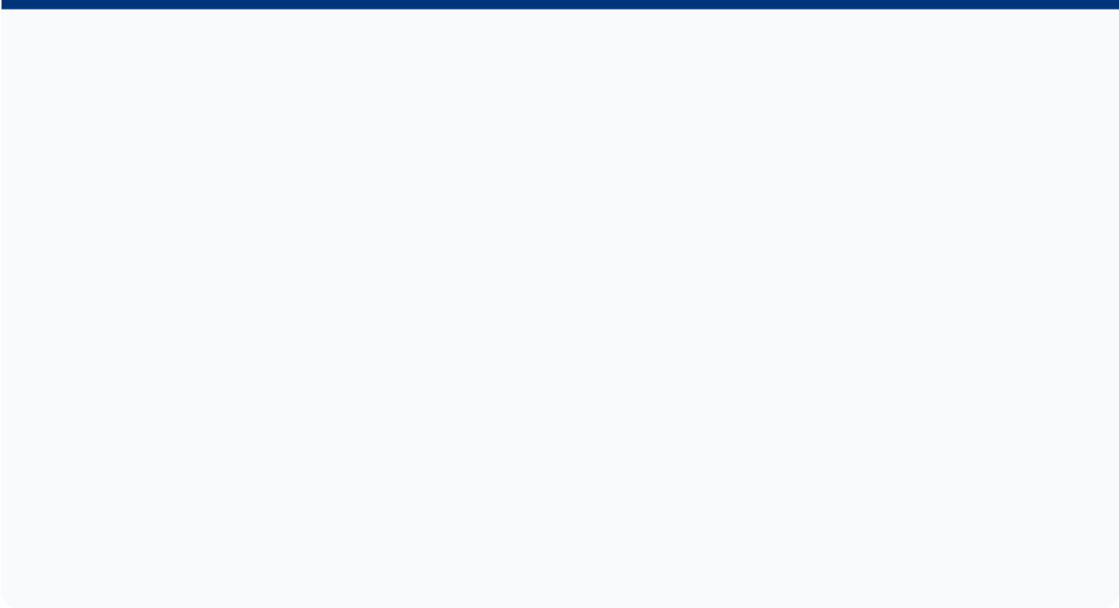
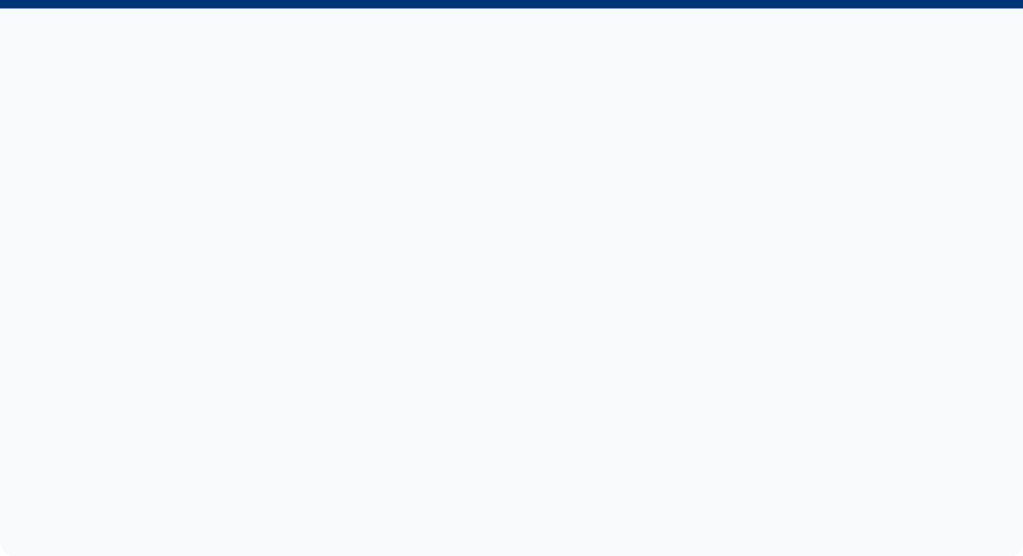






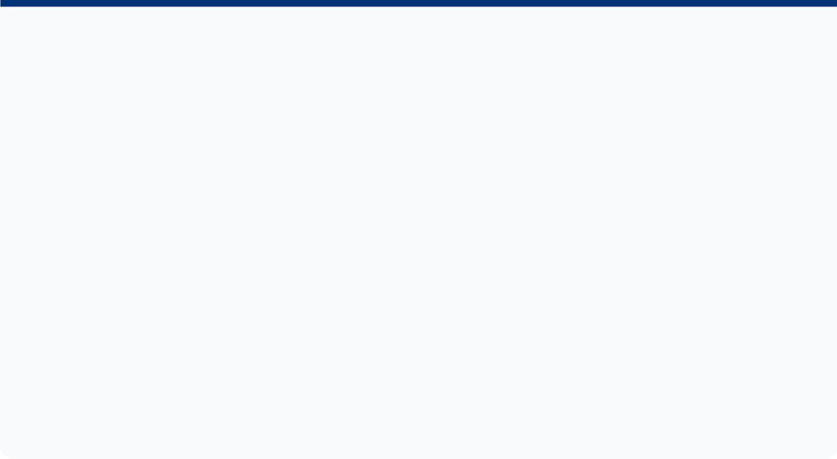

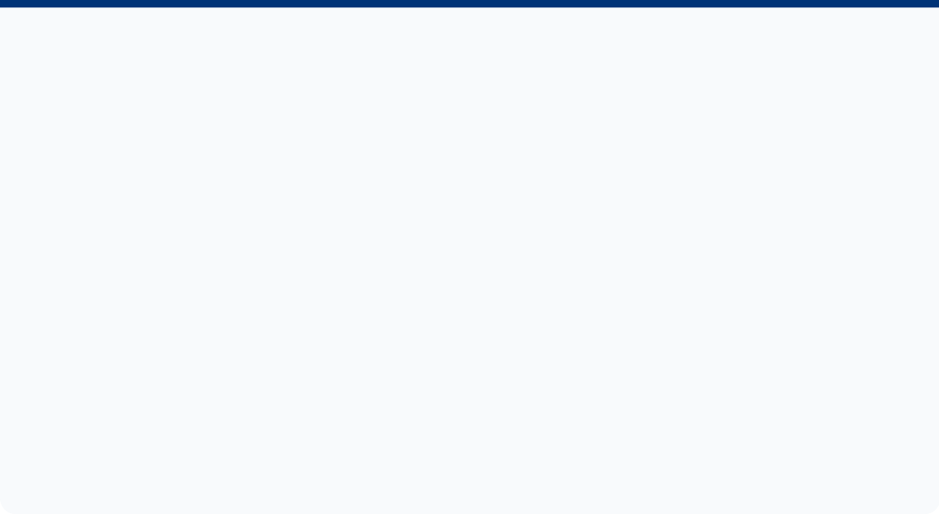






Modern CRM Practices
Transforming Customer Experience through Digital Innovation
Omni-Channel Engagement
Connected Vehicle Data
Automated Communications
Seamless integration across FordPass app, dealerships, website, and social media for a unified customer journey.
Utilizing telematics for proactive maintenance alerts, usage-based insurance, and personalized health reports.
AI-driven email campaigns and FordPass push notifications tailored to driving behavior and purchase history.
FordPass Rewards
EV Customer Journey
Service Excellence
Points-based loyalty program incentivizing vehicle services, new purchases, and customer referrals.
Specialized digital touchpoints for range management, home charging setup, and over-the-air (OTA) software updates.
Blue Oval Certification ensures consistent, high-quality service standards across the global dealer network.
FORD+ DIGITAL STRATEGY
"Building Enduring Customer Relationships"
CRM Project

Slide 6
















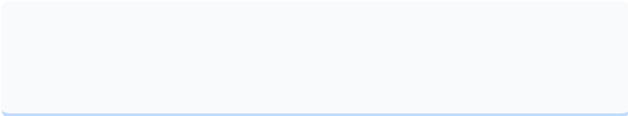
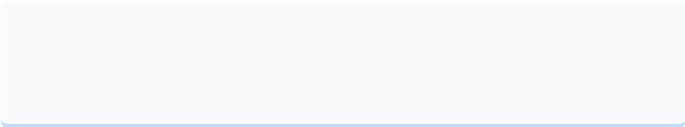
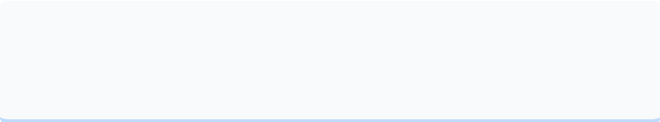
Management Supporting CRM
Leadership, Alignment, and Technology Ecosystem
Organizational Alignment
Strategic Leadership
Technology Stack
CEO Jim Farley: Championing a "Customer-First" culture.
Cross-Functional: Sales, Marketing, and IT integration.
Salesforce CRM: Unified customer profiles.
Ford+ Plan: Transformation focused on digital services.
Dealer Empowerment: Real-time performance dashboards.
Adobe Experience: Personalized marketing automation.
Voice of Customer (VoC) Programs
Systematic Feedback
Social Listening
NPS Scoring

Slide 7


















Data Analysis Overview
Predictive Modeling for Customer Retention & Churn
DATASET PROFILE
TECHNICAL STACK
120,000
Python Core
Scikit-learn
Synthetic CRM Records
Matplotlib
Lifelines Lib
Demographics: Age, Income Segments
Behavior: Purchase Frequency, Avg Order Value
MODELING PIPELINE
Metrics: Loyalty Score, Churn Status (0/1)
1
Exploratory Data Analysis (EDA)
CORE OBJECTIVES
2
Logistic Regression & Feature Importance
Build high-precision predictive models to identify at-risk customers and estimate Customer Lifetime Value (CLV) through survival analysis.
3
Random Forest & Decision Tree Classifiers
4
Kaplan-Meier Survival Analysis
FORD CRM PROJECT
PHASE 4: QUANTITATIVE RESEARCH

Slide 8
















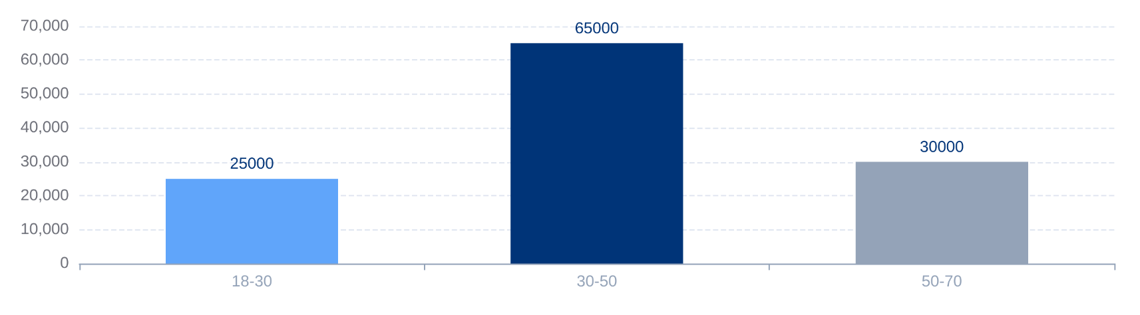
Exploratory Data Analysis
CRM PROJECT | SLIDE 08
Dataset Insights & Customer Demographics
TOTAL RECORDS
CHURN RATE
HIGH INCOME SEGMENT
120,000
30%
Correlation 0.61
Demographic Profile
CUSTOMER CHURN DISTRIBUTION
Age Range: 18–70 years old; primary segment identified in 30–50 age bracket.
Income Impact: Strong positive correlation with purchase frequency and brand loyalty scores.
Churn Drivers
Purchase Frequency: Customers with higher frequency show significantly lower churn probability.
DEMOGRAPHIC DISTRIBUTION (AGE)
Income Level: Higher income segments exhibit lower churn and higher customer equity.
Synthetic CRM Dataset Analysis | Predictive Modeling Preparation

Slide 9





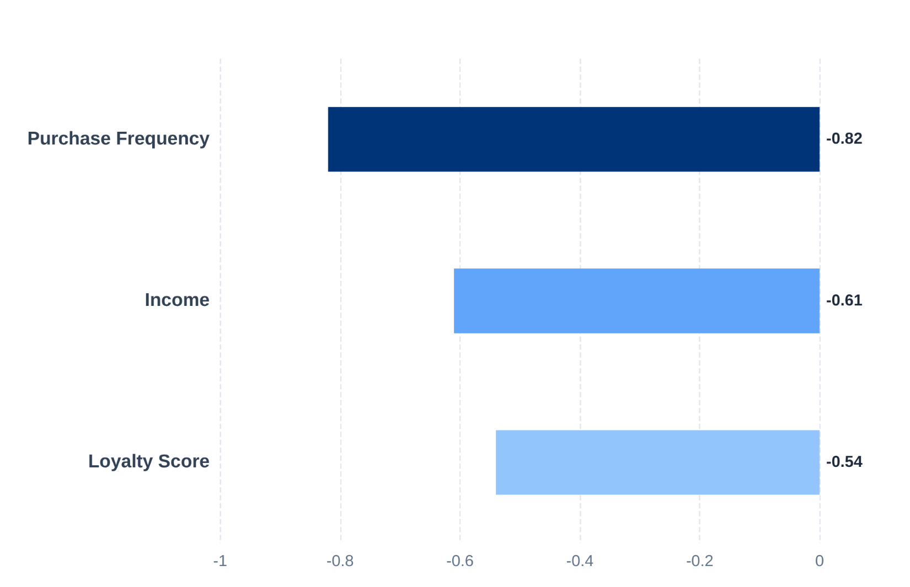








Churn Factor Analysis
~68%
MODEL ACCURACY
Logistic Regression Results & Predictor Identification
Top Churn Inhibitors
Feature Coefficients
Negative values indicate a reduction in churn probability (Inhibitors).
Features that significantly reduce the probability of customer churn:
Purchase Frequency:
The most powerful predictor; frequent interaction builds habit and loyalty.
Income Level:
Higher-income segments show greater brand stability and lower price sensitivity.
Loyalty Score:
FordPass Rewards enrollment is a strong indicator of long-term commitment.
Primary Churn Drivers
LOW ENGAGEMENT
AGE SEGMENTS
Long periods since last service visit.
Higher churn risk in younger demographics.
Business Implication: Proactive engagement with low-frequency buyers and low-income segments is critical for reducing overall churn.

Slide 10





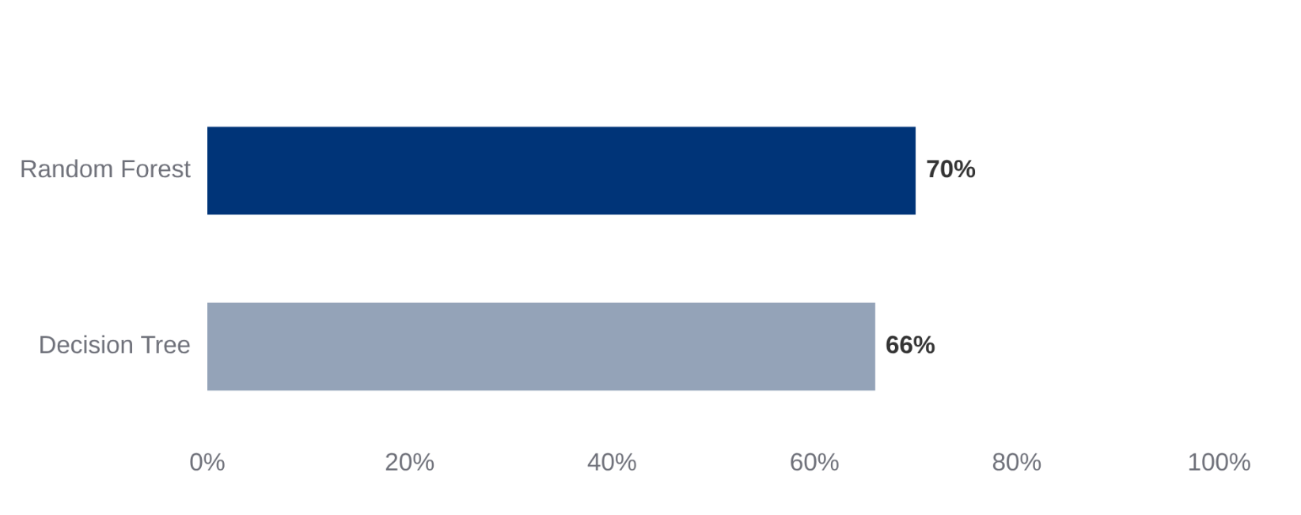
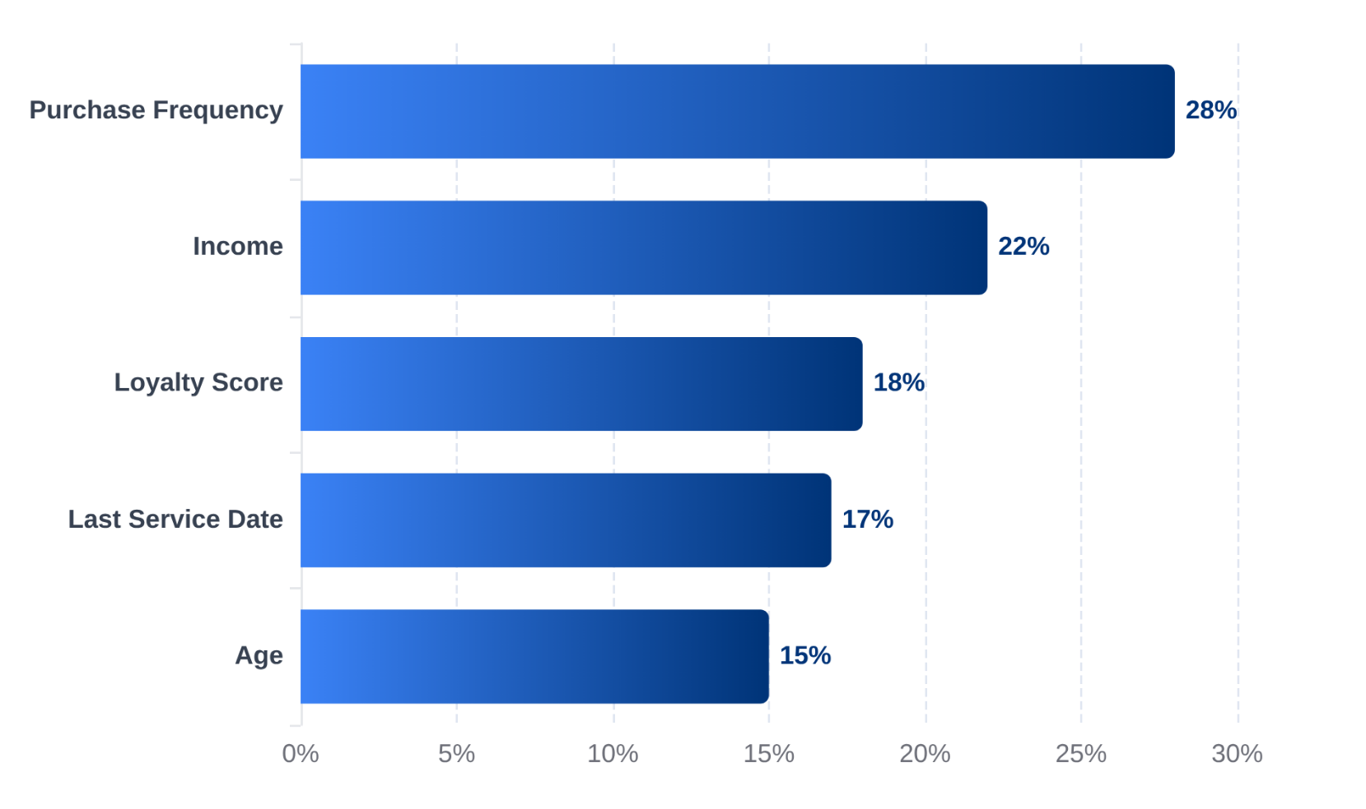






Machine Learning Results
Predictive Modeling Comparison & Feature Importance
Model Comparison
Feature Importance
Random Forest Weightings
PRECISION
RECALL
F1-SCORE
0.71
0.68
0.69
BUSINESS IMPLICATION
Flag customers with <3 purchases/year
Proactive outreach for below-median income segments

Slide 11


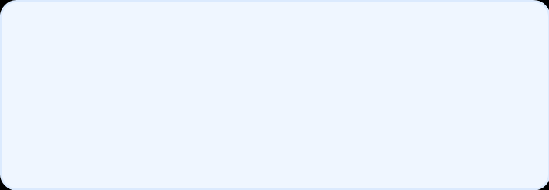
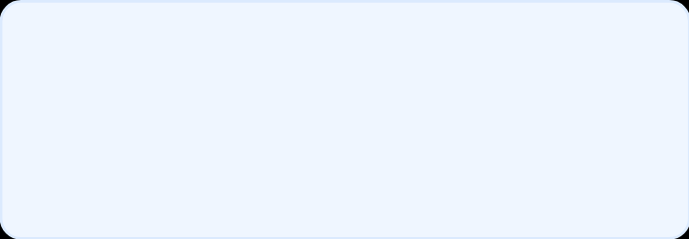

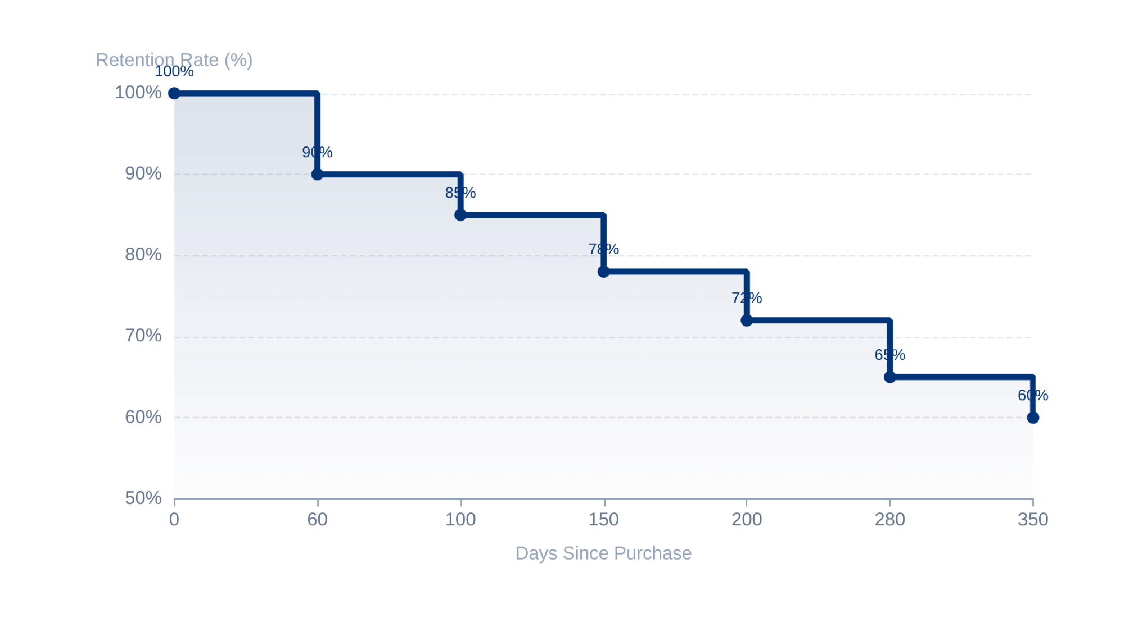





Customer Lifetime Value (CLV) Survival Analysis
Predicting Retention with Kaplan-Meier Modeling
PHASE 4: DATA ANALYSIS
CUSTOMER RETENTION CURVE
MEDIAN CLV
YEAR-1 RETENTION
280 Days
60%
Critical Onboarding Period
The first 60 days are vital; early engagement programs significantly reduce initial drop-off.
Retention Milestones
85% retention at Day 100; drops to 72% by Day 200 before stabilizing near one year.
Business Implication
Focusing resources on Day 0-60 yields the highest ROI for long-term customer equity.
ACTIONABLE INSIGHT
"Survival curves stabilize after 150 days. The battle for retention is won or lost in the digital onboarding experience."
Survival curve shows percentage of active customers over a 350-day period.
Predictive Modeling • Kaplan-Meier Method • CRM Strategy
FORD MOTOR COMPANY

Slide 12





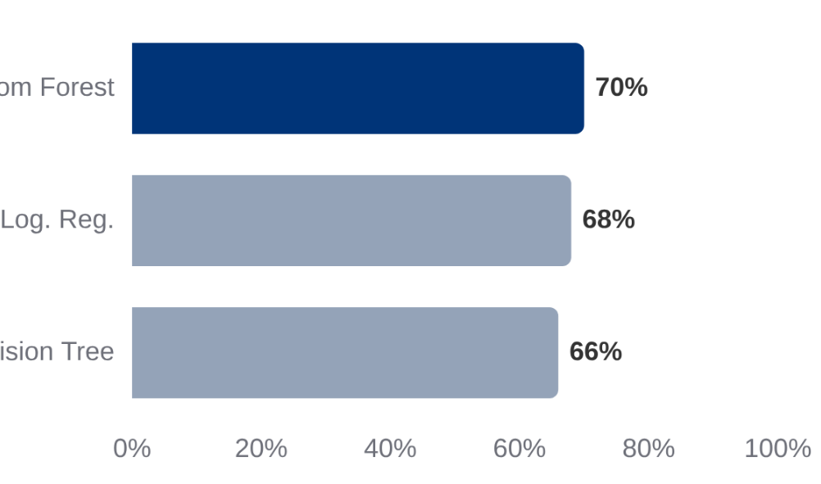





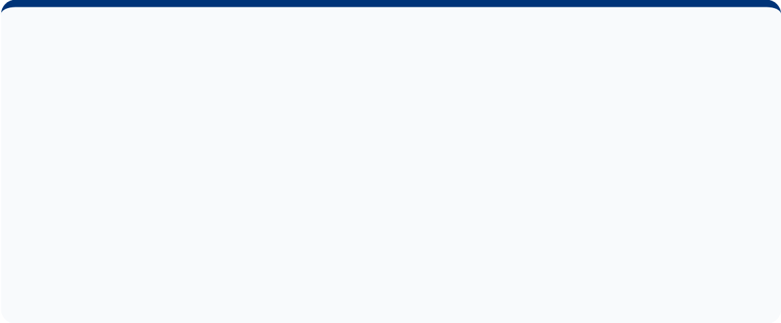




Key Research Findings
Insights from Customer Data Analysis & Predictive Modeling
Purchase Frequency
Digital Ecosystem
Model Accuracy Comparison
High-frequency purchasers (3+ transactions/year) exhibit significantly lower churn rates, driving depth of engagement.
FordPass is critical; connected vehicle owners show higher engagement scores and brand loyalty.
Income Correlation
Critical 60-Day Window
Income is a strong predictor of churn. Low-income segments require targeted retention and flexible financing.
Customers without FordPass engagement or service within 60 days are 3x more likely to churn.
Random Forest outperformed other models in predicting churn risk.
AI Predictive Power
Customer Equity
Machine learning (Random Forest) proactively identifies at-risk customers with 70% accuracy.
Equity is maximized when combining digital engagement, service loyalty programs, and personalization.
Survival Stat
60%
Customers retained beyond one full year (350+ days).
FORD MOTOR COMPANY CRM PROJECT
FINDINGS & ANALYSIS

Slide 13









Strategic Recommendations
Optimizing Customer Retention & Lifetime Value
FORD+ TRANSFORMATION PLAN
Proactive Service Alerts
Targeted Segment Support
60-Day Onboarding
Leverage Connected Vehicle Data (telematics) to send automated maintenance reminders, reducing service gaps and reactivating dormant users.
Develop income-sensitive loyalty rewards and flexible financing packages for at-risk segments to maintain price-sensitive loyalty.
Implement a structured journey within the critical first 60 days including FordPass enrollment incentives and first service scheduling.
Churn Scoring Dashboard
Unified Loyalty Ecosystem
Integrate Random Forest predictive models into dealer CRM systems to provide real-time "at-risk" scores for proactive outreach.
Unify FordPass, Ford Credit, and Dealership points into a single rewards ecosystem to drive multi-touchpoint brand engagement.
APPLICATIONS OF CRM TECHNIQUES
Page 13 of 15

Slide 14




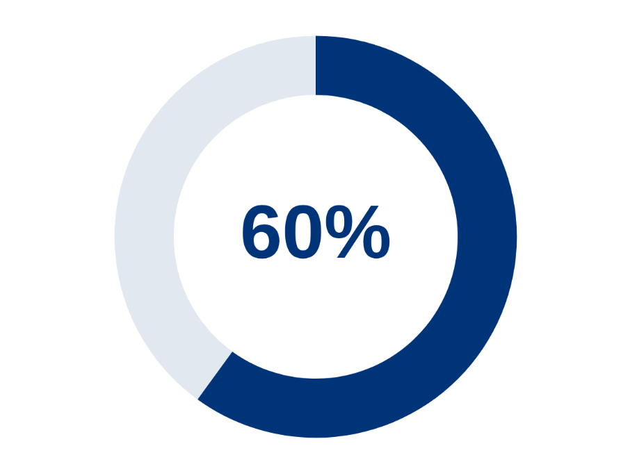







Conclusion
Ford's CRM as a Strategic Organizational Capability
Transformative Strategy
Ford has evolved CRM from a tech tool into a strategic capability, moving beyond transactions to build enduring customer equity.
Long-Term Retention Success
Omni-channel Integration
Seamlessly connecting FordPass, connected vehicle data, and AI analytics.
Lifelong Advocacy
Transforming one-time buyers into brand advocates through personalized relationships.
KEY PERFORMANCE INDICATOR
60% Retention
Future Outlook
Customers retained beyond one full year
Expansion of FordPass capabilities and proactive churn prevention programs.
"Building Enduring Customer Relationships —
One Data Point at a Time"

Slide 15

Thank You!
We welcome your questions and feedback.
Q&A Session
PROJECT CONTEXT
PROJECT TEAM
Customer Relationship Management
Sujana S
Daphni Michelle B
Applications of CRM Techniques at Ford
Sree Darshne J
Haripriya T N
"Building Enduring Customer Relationships — One Data Point at a Time"

